Slide 1
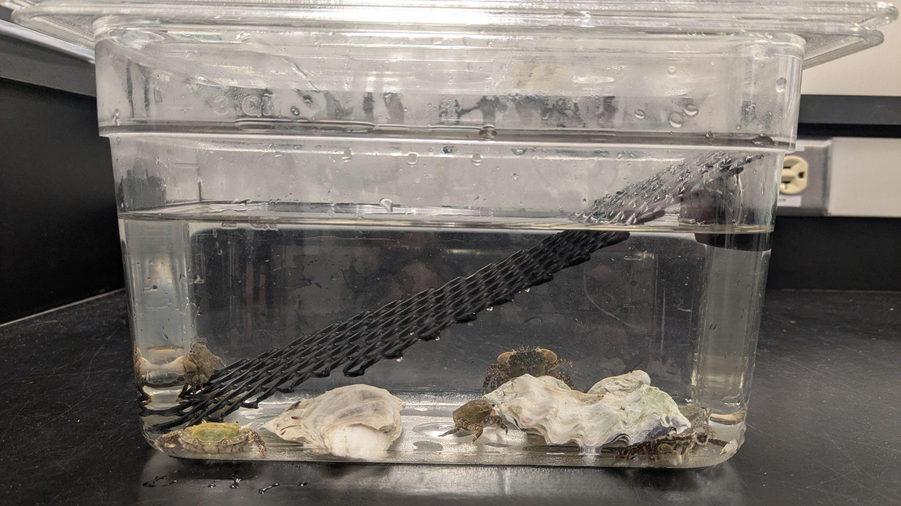
PRELIMINARY RESULTS
“How will hypoxia affect the physiology of hairy shore crabs?”
Intertidal treatment set-up
Will Mixon, Maddy Glasser, GG Foster, Erik Bengtson

Slide 2
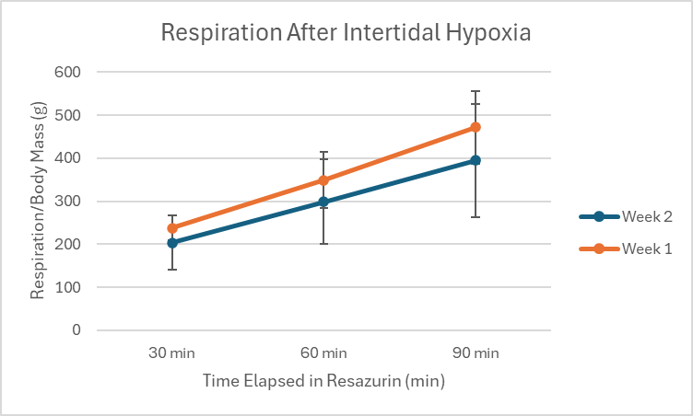
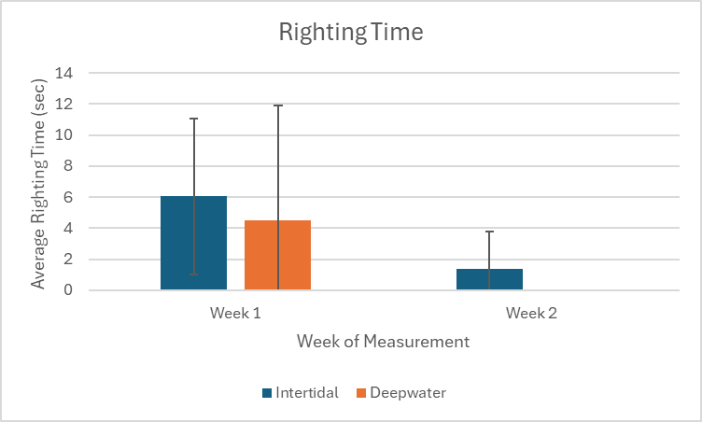
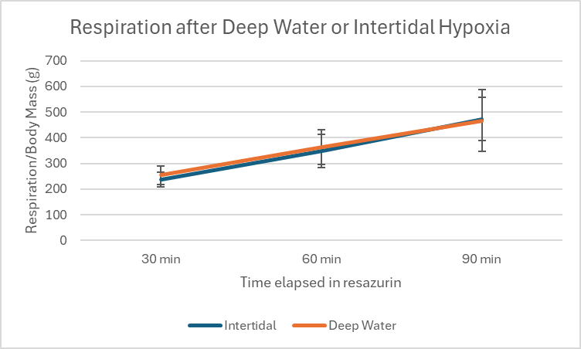
Behavior & Respiration
Resazurin
Righting Time
Hypoxia
Mortality of deepwater treatment in week 2
Overwhelming error
Needed more replications
* 100% mortality of deepwater treatment after two weeks, one deceased from intertidal after two weeks

Slide 3
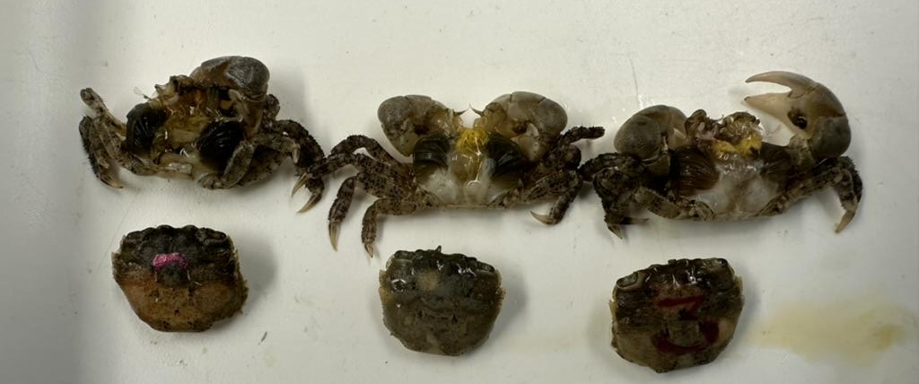
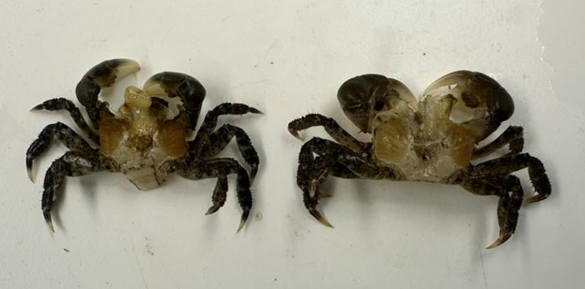
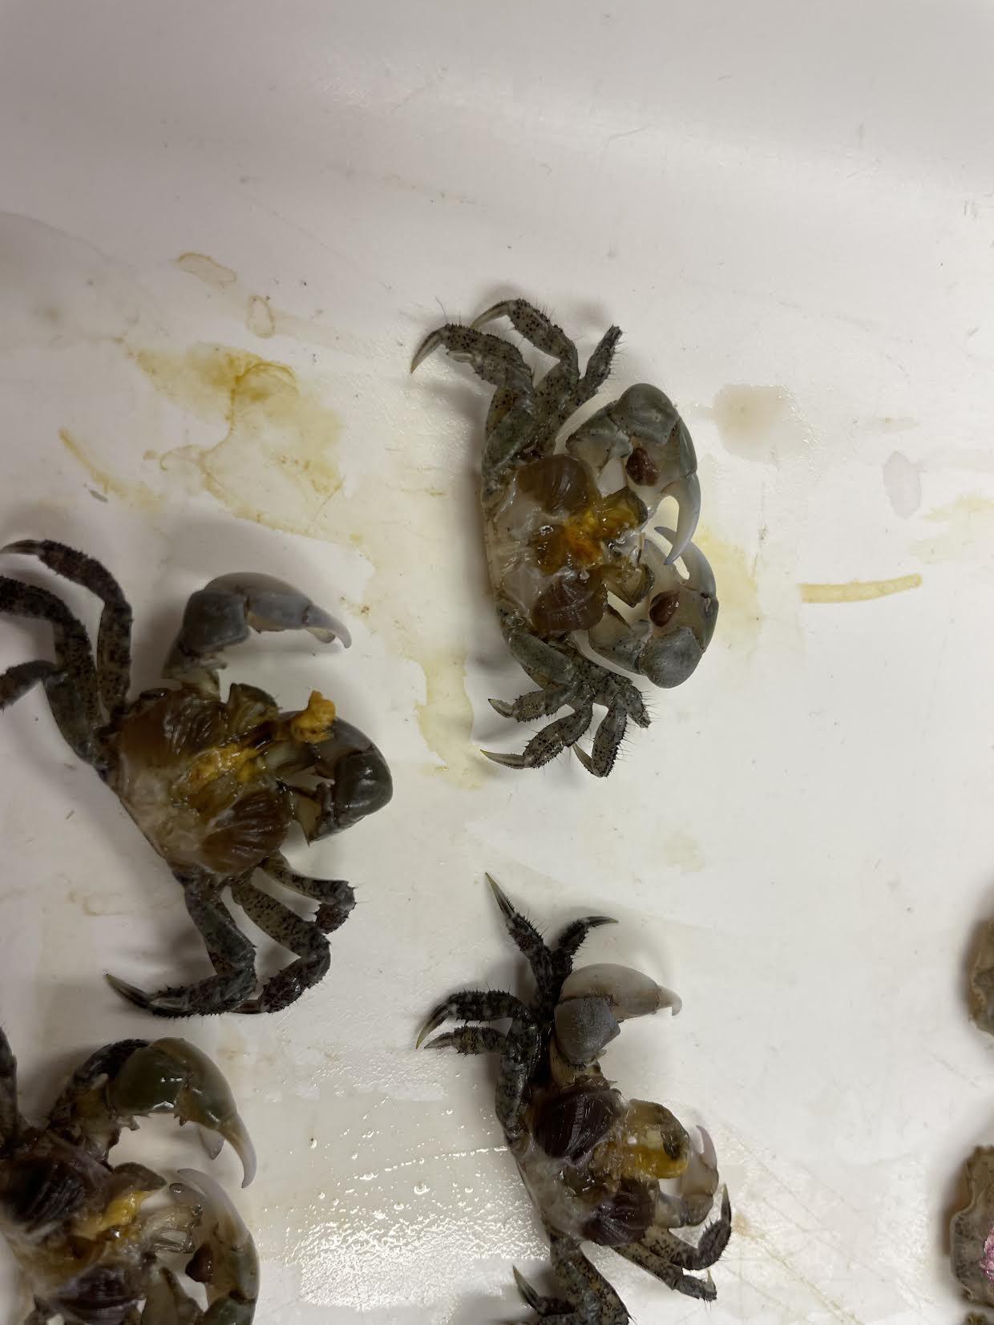
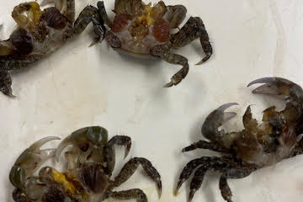
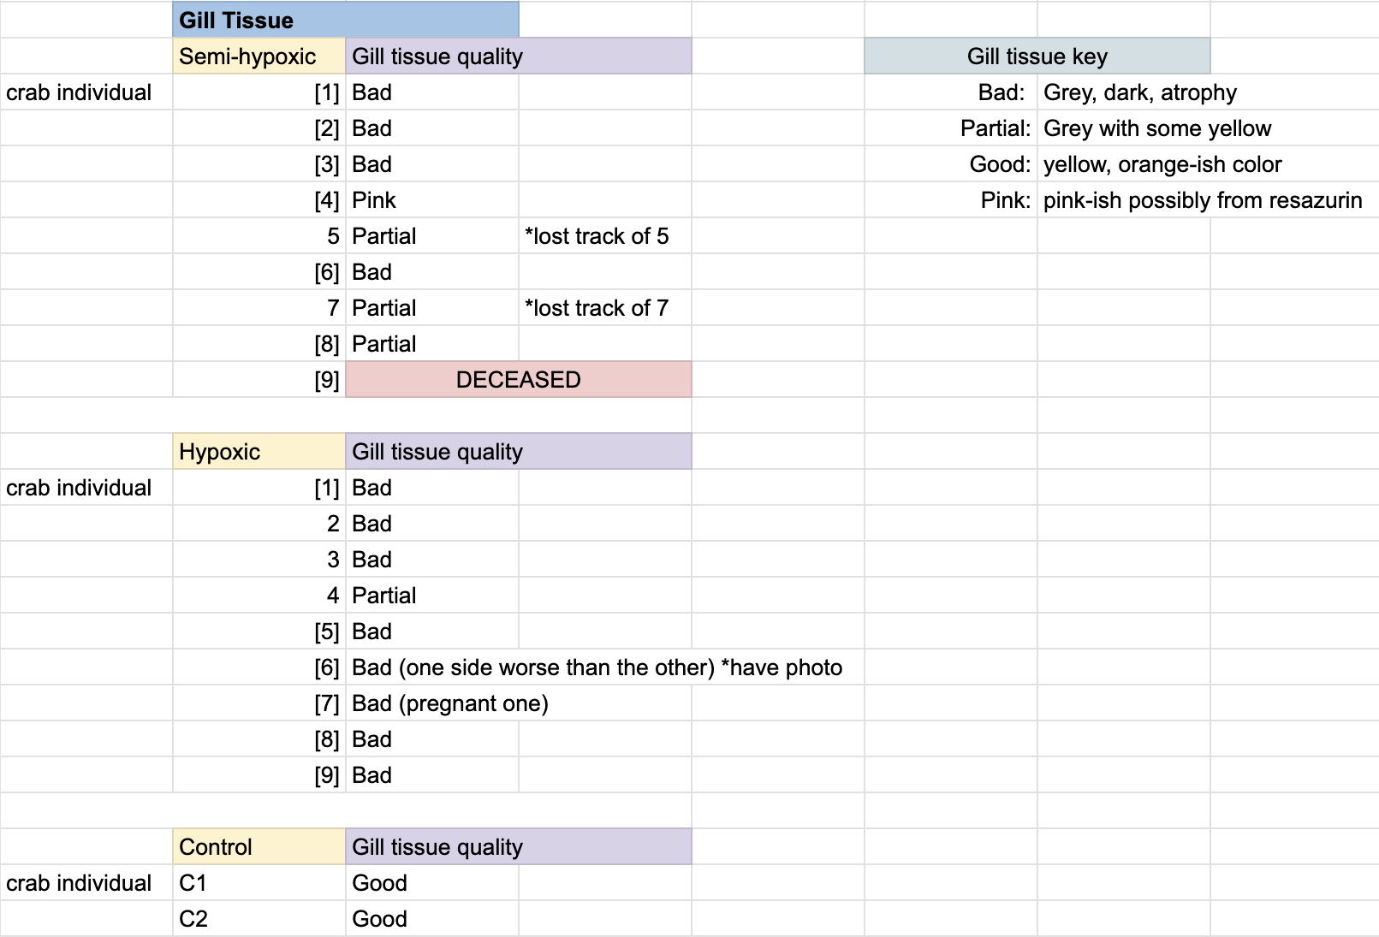
Dissection - Gill Tissue
Hypoxia
Control
Deepwater
Intertidal
Notes:
Gill tissue in the control crabs were yellow and plump. Crabs subjected to fully hypoxic conditions displayed dark grey and deteriorated gills. Crabs subjected to semi-hypoxic conditions (the ones with access to air) had a range of gill tissue deterioration. Some were completely dark and decayed while other were partially decayed and were a greyish/brownish yellow. One of the intertidal crabs had gill tissues that were stained pink by resazurin and its condition could not be determined.

